Slide 1
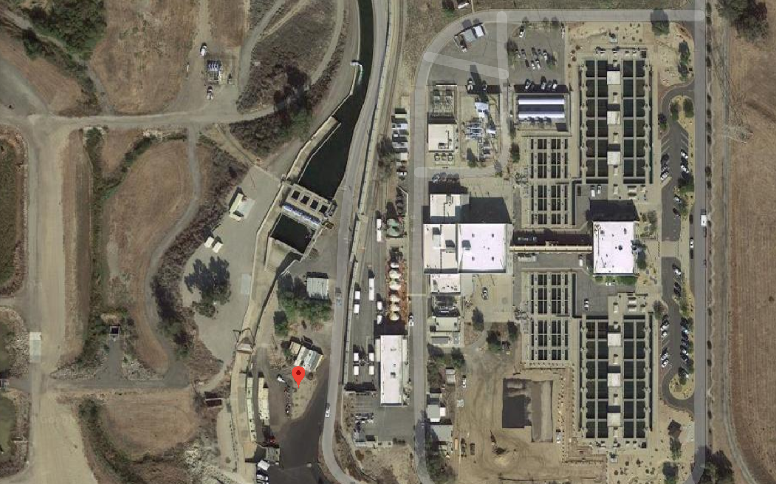
CEE 4590: Water Treatment Capstone
An Introduction
Monroe Weber-Shirk

Slide 2
History of this class
CEE 3520 – I took this class in 1985
Sparked my interest in slow sand filters because I learned that we didn’t know how they worked
Something was missing
Safe water on tap – I created that course in fall of 2004 to connect physics to surface water treatment with a focus on new technologies developed by the AguaClara program
CEE 3520 canceled after 2005
CEE 4590 provide an overview of traditional water treatment processes AND to provide a capstone project for a major city

Slide 3
Introductions
My name is…
The most recent water (or wastewater) treatment plant that you visited and one thing you noticed at that plant.
My name is…
The names of the two previous students

Slide 4
Pedagogy
“When we educate engineers, we frequently emphasize predefined, decontextualized, closed-ended technical problem solving... Yet practicing engineers work to define and solve complex contextualized, open-ended sociotechnical problems.” - Jon A Leydens & Juan C. Lucena
Life is not a lecture and a problem set
Life will be learning by doing (and taking advantage of educational resources)
My role is to be a guide by your side and create a safe space for learning
Notes:
Engineering Justice Transforming Engineering Education and Practice
Jon A Leydens, Juan C. Lucena IEEE PCS Professional Engineering Communication Series: Traci Nathans-Kelly, Series Editor (2018)

Slide 5
Reflections on Life Long Learning
How did you learn when you were 3?
How will you learn when you are 30?
How do you want to respond when you need to do something that you’ve never done before or when you are asked to solve a problem that is completely new to you (and there aren’t office hours)?
Just in time learning – learning based on what you need to be able to complete the task at hand

Slide 6
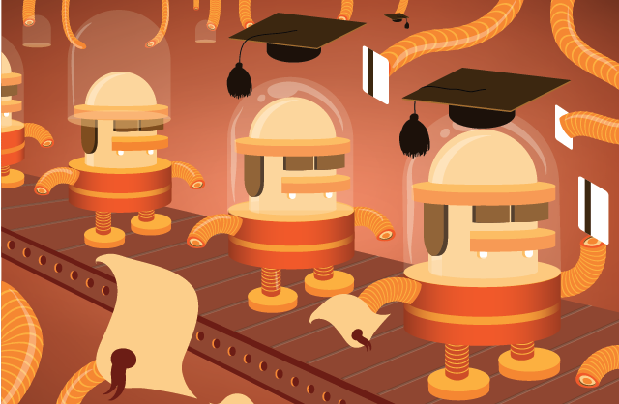
What is wrong with the widget model of education?
The Widget Theory of Higher Education is that a college or university is a manufacturing enterprise that produces products called academic degrees in basically the same way as a company such as Universal Widgets, Inc. produces widgets. Like widgets, academic degrees come in several models and price ranges.
Break into teams of 3 and identify at least 3 reasons why being educated as a widget is not what you want.
https://www.insidehighered.com/views/2013/01/08/essay-flaws-treating-higher-education-widget-factory
Notes:
It assumes that the problems that need to be solved have already been solved in the textbooks.
It is the same fallacy as the idea that we can close the patent office.
When there is a new problem it is time to hire a new widget.
Fails to recognize our ability to learn

Slide 7
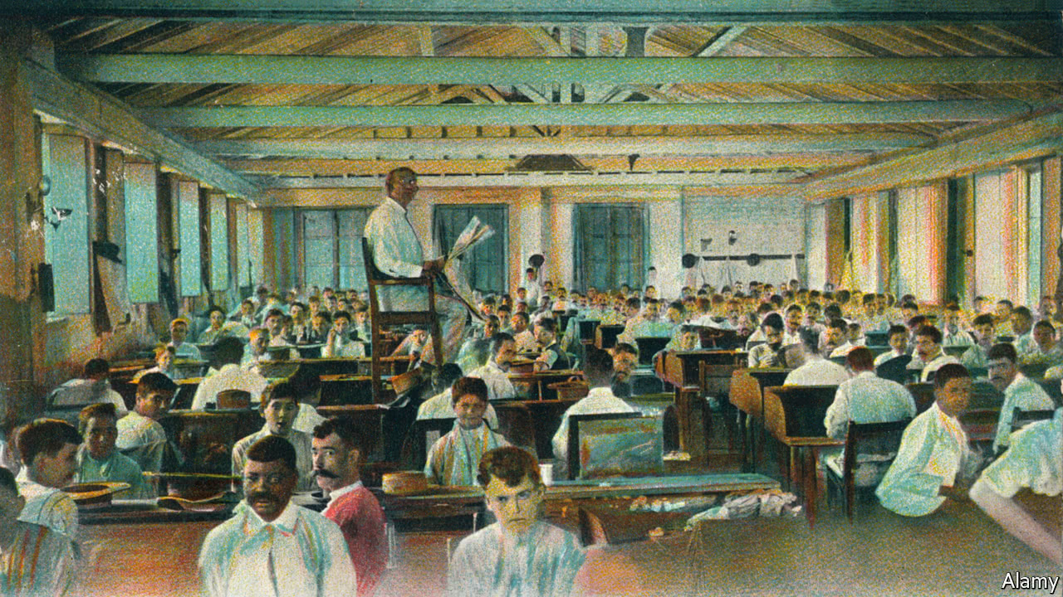
Why are there lectures? Why am a senior lecturer?
What was the historical context?
The people who read to Cuban cigar-factory workers
Why were lecturers necessary?
It puts kids to sleep — but teachers keep lecturing anyway. Here’s what to do about it. By Valerie Strauss in the Washington Post
Notes:
https://www.economist.com/the-americas/2017/10/12/the-people-who-read-to-cuban-cigar-factory-workers
https://www.washingtonpost.com/news/answer-sheet/wp/2017/07/11/it-puts-kids-to-sleep-but-teachers-keep-lecturing-anyway-heres-what-to-do-about-it/

Slide 8
Given the printing press (and the internet) and how we learn best; how should a course be designed?
Course design
Role of instructor
Diversity of topics (urban vs rural)(social impact of a WTP)
Ability to learn on your own and apply to a new open-ended design
Sharing of resources/collaboration
Team based projects
Critical thinking/problem solving
Giving thought provoking problems that are manageable
Talk with actual engineers
Lessons learned
Grading based on learning vs achievement of milestones
Challenge us in same way as real life with project expectations and connect with client
Examples of approach of problems/case study/stories of experience
Breakdown assumptions made by client and guide student through new topics
Notes:
Have students work on this in teams of 3. Come up with 2 ideas for each heading.
Then randomly call on 4 teams to share. 2 teams share ideas for course design. 2 teams share ideas for role of instructor.
What kind of an environment do you need to learn?
What should be done in class time?
What type of educational activities or learning opportunities should be provided?
Type of prelims
What is my role?
Librarian (curator of resources)
Devise authentic learning experiences (What does authentic mean?)
Goal is to develop skills that will translate to new problems.
NOT FE exam style problems

Slide 9
CEE 4590: Water Treatment Capstone
With a focus on physical chemical processes
For water that might be destined for municipal drinking water or injection into an aquifer, or return to a pristine lake
Working with an engineering firm in the United States
To design a water treatment facility for a large city

Slide 10
An introduction to water quality and traditional treatment technologies
Water Quality Considerations
EPA Primary & Secondary MCL; State Primacy Enforcement (Chapter 1 – 4 )
Unregulated Water Quality Issues (Chapter 1 – 4)
Emerging Contaminants (Chapter 4, 20)
Conventional Water Treatment Processes (focus on particles and pathogens)
Screening, Coagulation, Flocculation (Chapter 9)
Sedimentation (Chapter 10)
Granular Filtration (chapter 11)
Membrane Filtration (Chapter 12)
Disinfection (Chapter 13)
Advanced Treatment Technologies (focus on dissolved species and chemicals)
Granular Activated Carbon (Chapter 15)
Ion Exchange Resins (Chapter 16)
High Pressure Membranes (Chapter 17)
Advanced Oxidation Process (Chapter 18)
Water Treatment Process Design Procedure (Chapter 23)
Chapters in MWH's water treatment
principles and design, third edition
John C. Crittenden ... [et al.].

Slide 11
My experience with the predecessor of this course in 1985
I felt like I didn’t really know how to design any of the unit processes
I certainly didn’t know what would happen if I tweaked the design

Slide 12
How did I know that I didn’t know how to design???
Before I studied engineering I built furniture in a wood shop
When you build things you quickly learn that there aren’t ANY dimensions that are arbitrary
ALL DIMENSIONS MATTER
So I learned how to design a flocculator…

Slide 13
Flocculator design 101
30 minute residence time
3 equal sized tanks (10 minutes each) with mixers in each flocculator
3 different power inputs (tapered flocculation)
Design flow (let’s take 1000 L/s)
Maybe 2 treatment trains (500 L/s each)
Each tank is 600 s * 500 L/s = 300,000 L = 300 cubic meters
Tank 6 m deep and 7 m x 7 m square
Done

Slide 14
The tanks each have 3 dimensions I only knew the volume!
There were 2 more degrees of freedom
How might those be selected? (What are the constraints?)
How would the 3 different power levels be selected?
Notes:
Brainstorm
Dimensions that are better for uniform mixing?
How do the flocculators fit in with the rest of the water treatment plant? (both plan view and elevation view)
Might it make sense to have the sed tanks and the flocculator share the same bottom elevation for ease of construction?

Slide 15
Resources Matrix: (https://github.com/monroews/CEE4590/wiki/Resource-Matrix)
We have multiple resources (and, of course, the internet)
MWH textbook
AguaClara textbook
Lectures given in a previous version of this course
EPA Water Treatability Database
CEE graduates who came to Cornell because of the AguaClara program who are now working for Stantec on the Fairmont Treatment Plant project

Slide 16
Tools: Or why we use Python in this class
Slide rule (I barely missed having to use this technology)
Calculators (reverse polish notation was awesome)
Paper and pencil so you can take exams!
Excel spreadsheets (goal seek and solver!)
Oh no… How will we give exams???
Engineering is about quantities that include units
Math works with units!
Excel doesn’t know what units are (unit conversions in Excel are so unreliable that I refuse to even look at engineering work done in Excel)

Slide 17
Why are units important?
Provide a minimum check on an equation for correctness
As an engineering you must develop an intuition for whether results that you calculate are reasonable and that requires units!
Complex designs have thousands of calculations and every one of those calculations has a significantly increased chance of an error if unit conversions are added to the calculation
Solution: Use computational tools that include units as part of the quantity

Slide 18
Why Python?
Open source
Growing in popularity
Open Source
No install required! (Share your work with your boss)
https://www.tiobe.com/tiobe-index/
Mathcad (my previous choice isn’t in the top 100 languages)
LabVIEW (my other current programming language is #44)
Matlab (ranked 20 and dropping fast)
Python (ranked 3)

Slide 19
Feedback!
I’m learning by doing too!

Slide 20
Let’s learn Python!
Colab
AguaClara package
Units
Learn by doing!

Slide 21
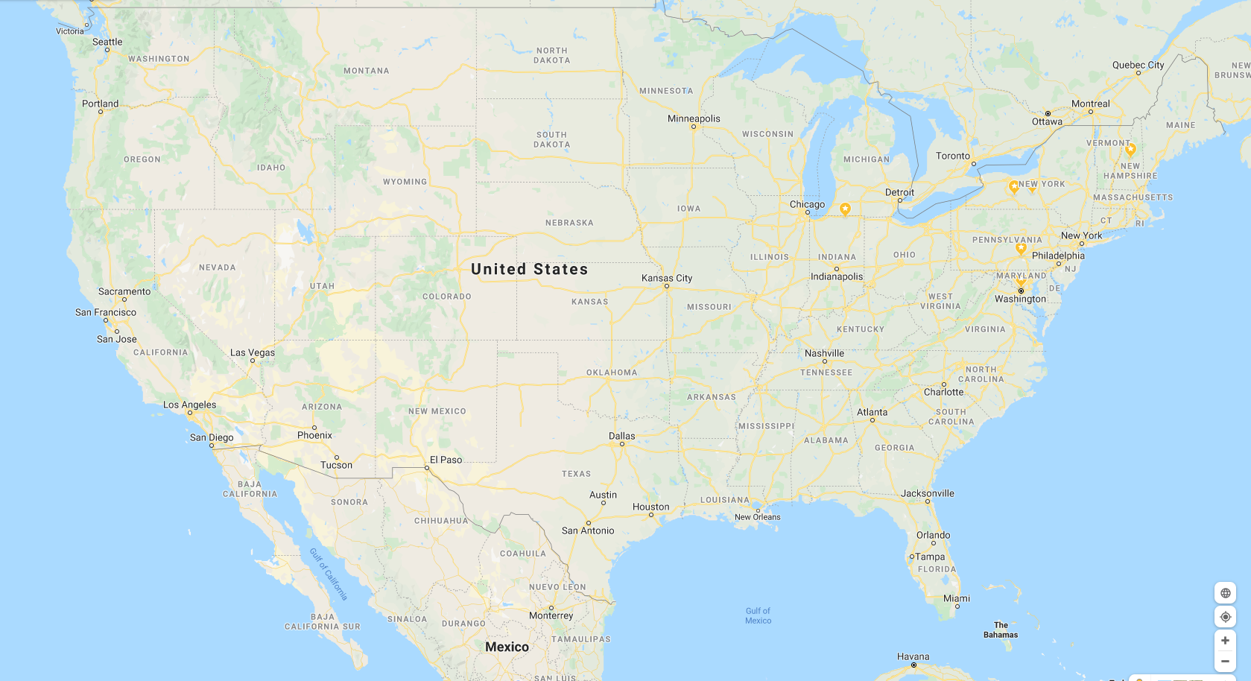

Slide 22
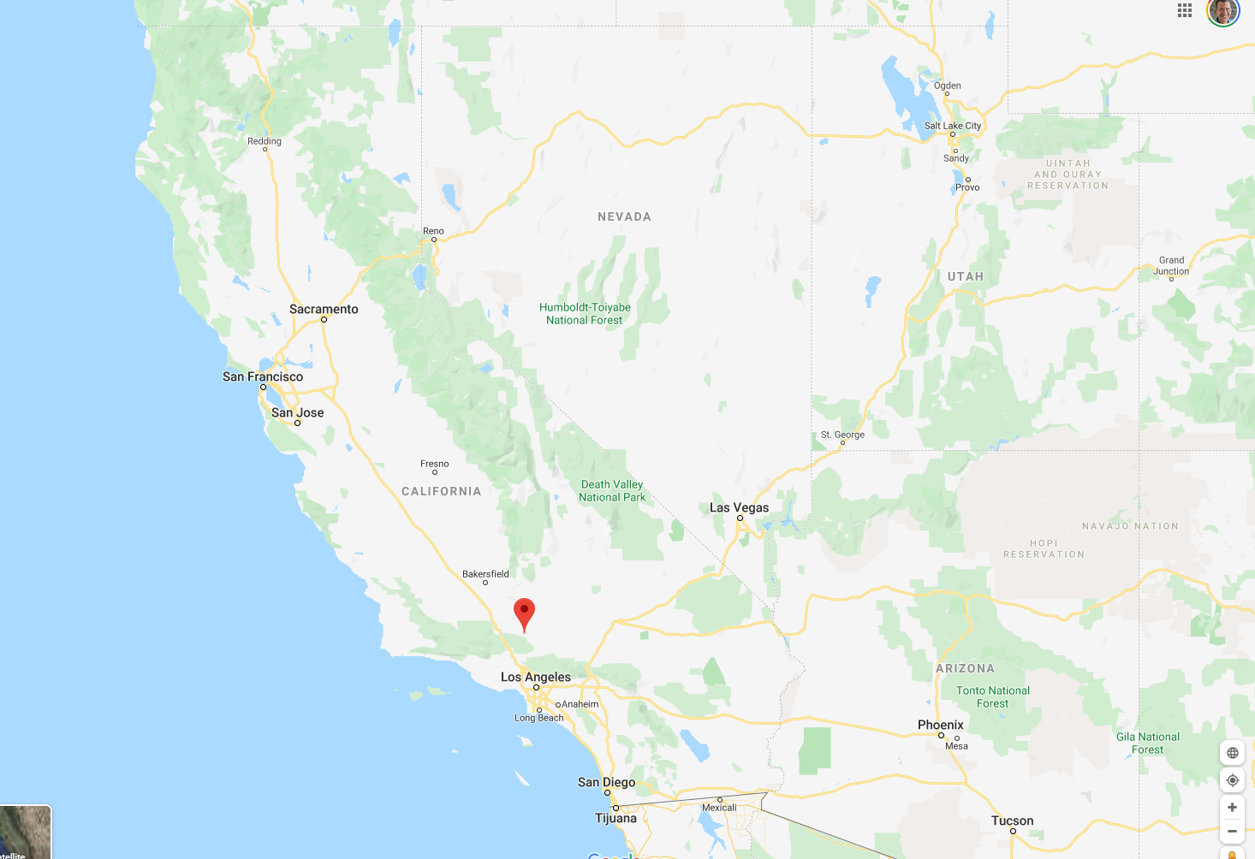

Slide 23
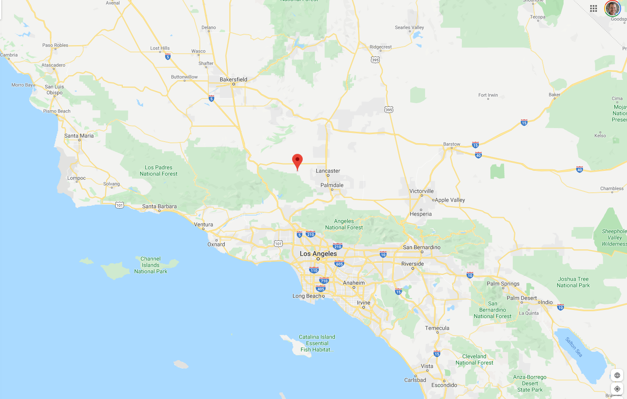

Slide 24
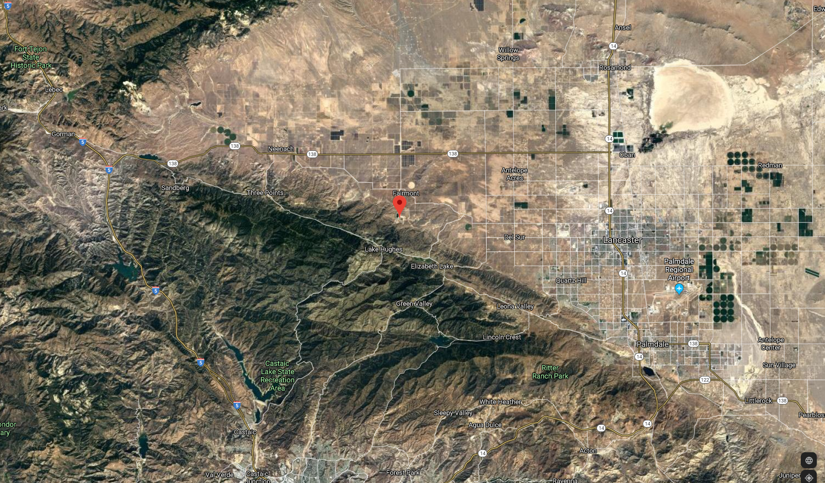

Slide 25
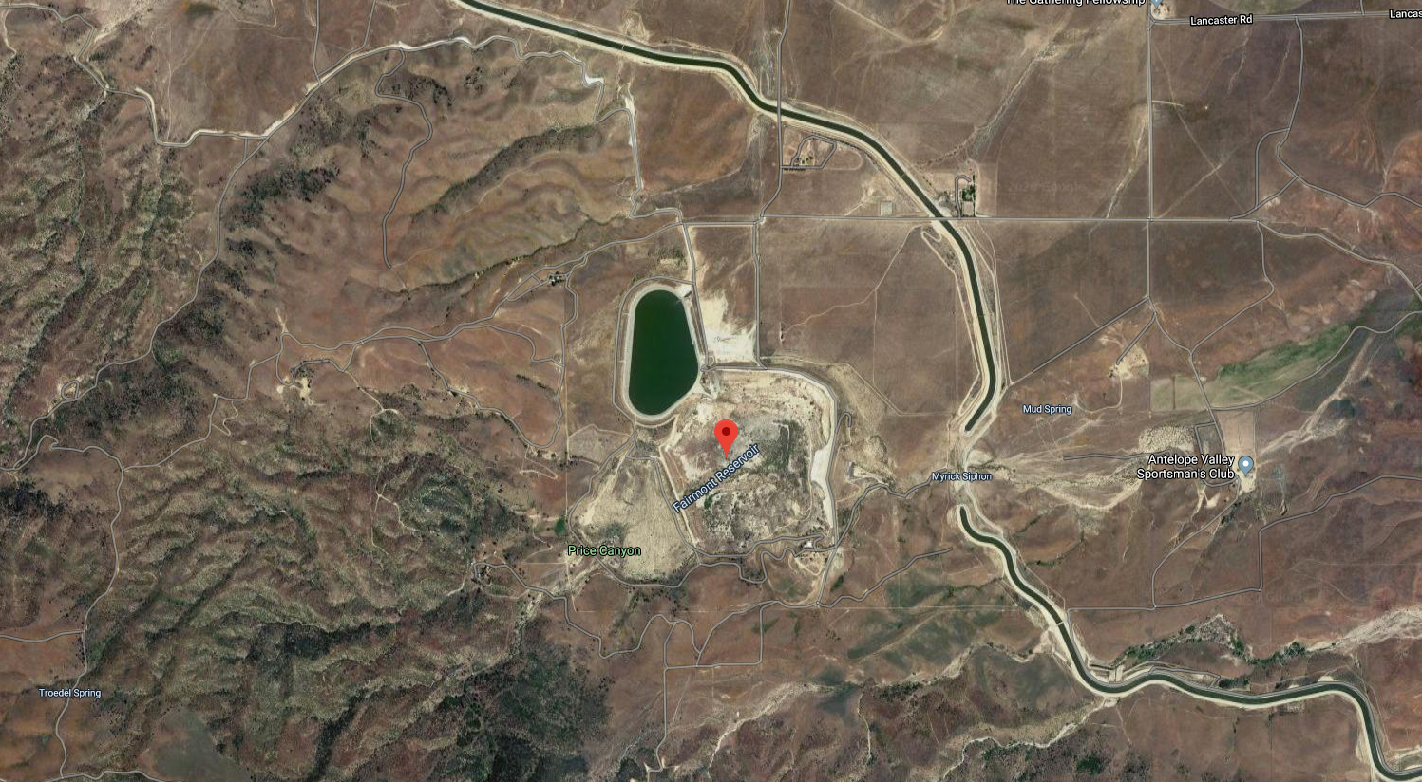
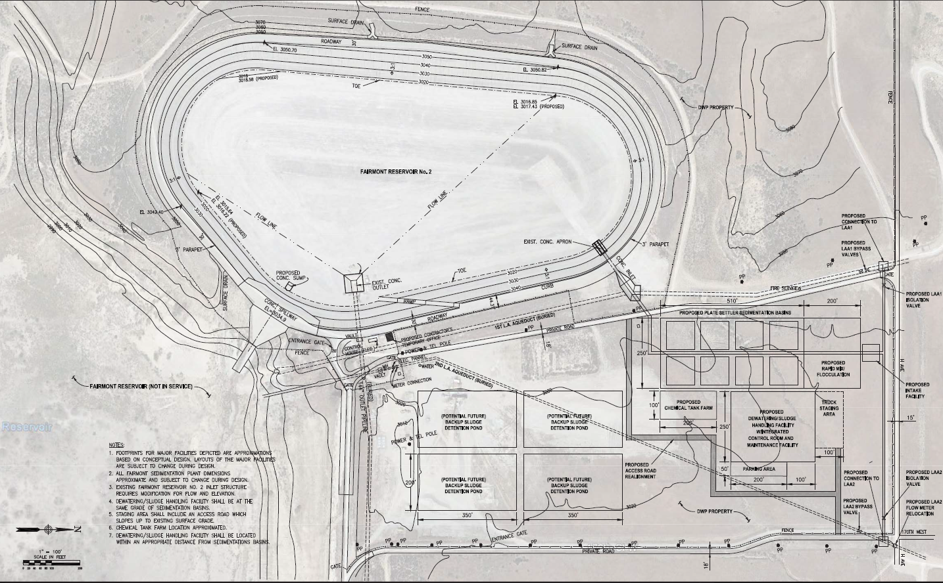
Future site of Fairmont Treatment Plant
Notes:
Inset from https://github.com/monroews/CEE4590/raw/master/LADWP/Fairmont%20Sedimentation%20Plant%20Scope%20of%20Work%20_FINAL%2006-01-17.pdf

Slide 26
https://github.com/monroews/CEE4590/raw/master/LADWP/Fairmont%20Sedimentation%20Plant%20Scope%20of%20Work%20_FINAL%2006-01-17.pdf
Notes:
https://github.com/monroews/CEE4590/raw/master/LADWP/Fairmont%20Sedimentation%20Plant%20Scope%20of%20Work%20_FINAL%2006-01-17.pdf

Slide 27
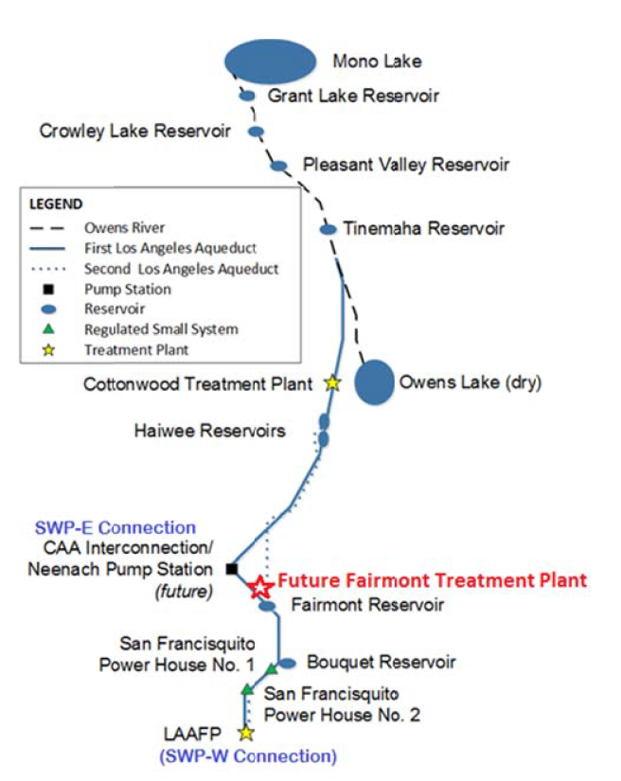
Cities and Resources
What is the context?
Why is Owens Lake dry?
Where did this water go before LA began to use it?

Slide 28
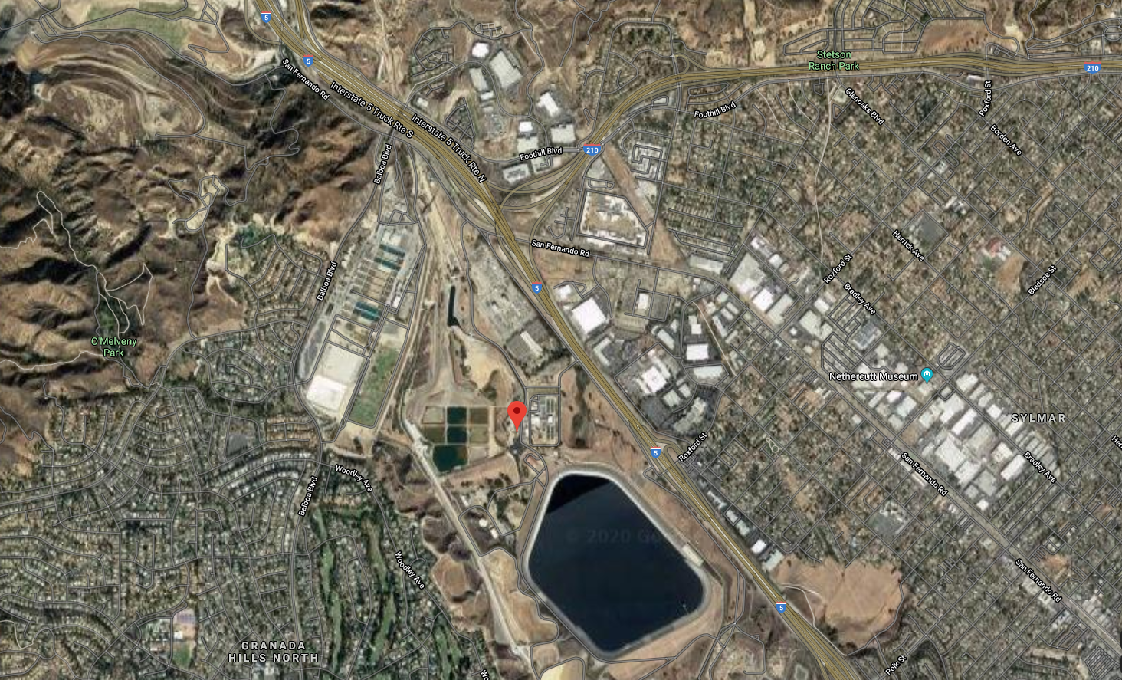
Los Angeles Aqueduct Filtration Plant
11 million cubic meters!
Notes:
https://www.google.com/maps/place/34%C2%B018'18.0%22N+118%C2%B029'20.4%22W/@34.3054299,-118.4887952,521m/data=!3m1!1e3!4m5!3m4!1s0x0:0x0!8m2!3d34.305!4d-118.489

Slide 29
Los Angeles Aqueduct Filtration Plant
Notes:
https://www.google.com/maps/place/34%C2%B018'18.0%22N+118%C2%B029'20.4%22W/@34.305725,-118.4890129,338m/data=!3m1!1e3!4m5!3m4!1s0x0:0x0!8m2!3d34.305!4d-118.489

Slide 30
How do you skim and evaluate the resources? Skepticism!
Traditional explanations of rapid mix, flocculation, floc blankets, and sand filtration should be viewed with skepticism because none of those processes have been well understood

Slide 31
Aware of what we know
Unknown
Knowns
Known
Knowns
Things that we think we understand that we don’t actually understand
Unknown – (Knowledge) - Known
Unknown
unknowns
Known
unknowns
Unaware – (Awareness) - Aware

Slide 32
What I thought I knew
Flocculation is charge neutralization
Unknown – (Knowledge) - Known
Observations are inconsistent with charge neutralization
Unaware – (Awareness) - Aware

Slide 33
Aware of what I know
New flocculation model
Unknown – (Knowledge) - Known
Observations are inconsistent with charge neutralization
Flocculation is charge neutralization
Unaware – (Awareness) - Aware

Slide 34
Reflections
What is something that you were confident that you knew that you then realized was incorrect?
What helped you realize that there was more to learn?

Slide 35
Signs that we are still figuring it out…
Lots of mechanisms that are all supposedly important
Example: slow sand filters: biofilms, predation, straining
Principle: usually one mechanism dominates in a process
Lots of equations, but no equations that lead to a design
Example: rapid sand filtration, flocculation, plate settlers
Principle: If the physics are understood, then equations for the design can be obtained
What went wrong with flocculation: Known principles applied to a new problem where those principles don’t apply
Notes:
Filtration equations only describe clean bed, but can’t predict how long a filter run will last or how deep the filter should be
Flocculation equations couldn’t predict the settled water turbidity.
Flocculation equations can’t predict the optimal velocity gradient
Plate settler equations couldn’t predict the plate spacing

Slide 36
So we are on an adventure

Slide 37
Generalize the design process
Water Source
Possible Unit Processes
Contaminants
Select Unit Processes
Disinfection Complications
Regulations
Sequence the unit processes
Client needs
Distribution Complications

Slide 38
Unit Processes
Rapid sand
Trash rack
Flocculation
Sedimentation
Slow sand
Membrane
Activated Carbon
Ion Exchange
Reverse Osmosis
Reverse Osmosis
Notes:
a. Screening, Coagulation, Flocculation (Chapter 9)
b. Sedimentation (Chapter 10)
c. Granular Filtration (chapter 11)
d. Membrane Filtration (Chapter 12)
e. Disinfection (Chapter 13)
3. Advanced Treatment Technologies (focus on dissolved species and chemicals)
a. Granular Activated Carbon (Chapter 15)
b. Ion Exchange Resins (Chapter 16)
c. High Pressure Membranes (Chapter 17)
d. Advanced Oxidation Process (Chapter 18)
4. Water Treatment Process Design Procedure (Chapter 23)

Slide 39
For each unit process
Concept: how does it work?
Types of contaminants that can be treated
Range of approach velocities
Range of hydraulic residence times
Energy required (J/L)
Inputs required or method of regeneration
Type of waste stream produced and disposal requirements

Slide 41
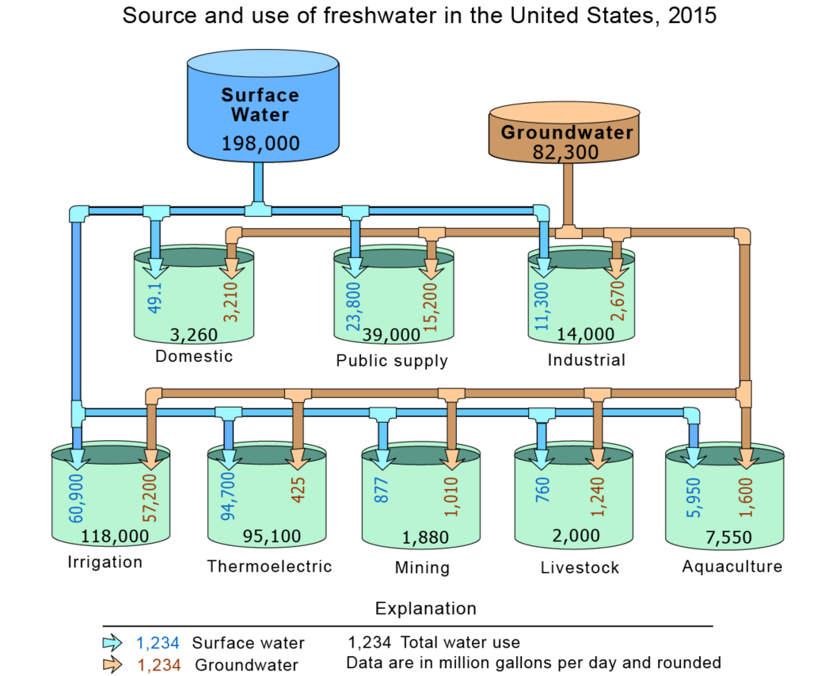
Water sources
https://www.usgs.gov/special-topic/water-science-school/science/groundwater-use-united-states?qt-science_center_objects=0#qt-science_center_objects

Slide 42
How do consulting firms, construction firms, venders, municipalities (clients) create a project?
We will hear about this process from Tori Klug and Michael Adelman (Engineers at Stantec) later in the semester.

